Slide 1
NEAT and ZoomZoom
Samuel Munro

Slide 2
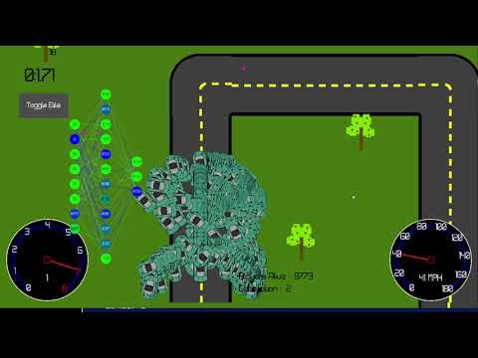
Background
Zoom Zoom
Multiplayer
Multi-Threaded
Fixed-topology Neural Network evolution
HW1 operations
High selection pressure
Biased crossover
10000 agents per generation
Computationally Intensive to Train
155 weights and biases to train

Slide 3
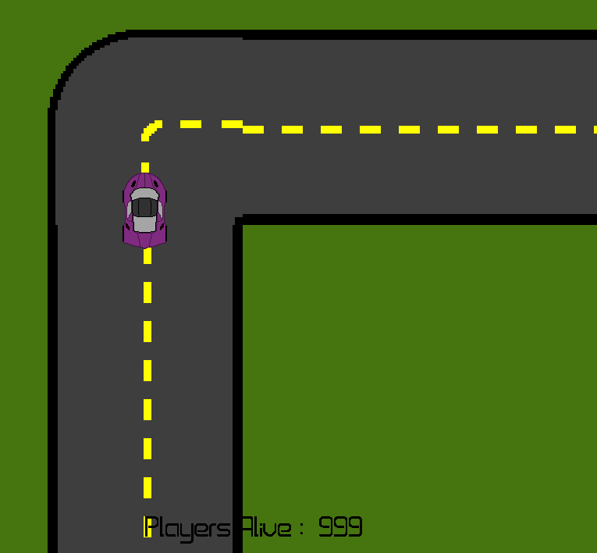
Evolution Parameters
Inputs
0-4: Track “Neighborhood” with radius 2.
1: right turn
-1: left turn
0: no turn
5-6: X and Y distance from center of the road
[-1, 1], 0 being in center
7: normalized speed of the car
Current Speed/Max Speed
[0, 1]
NEAT Library: Bias node as input
Different than fixed topology network
Example track neighborhood: [0, 0, 1, 0, 0]

Slide 4
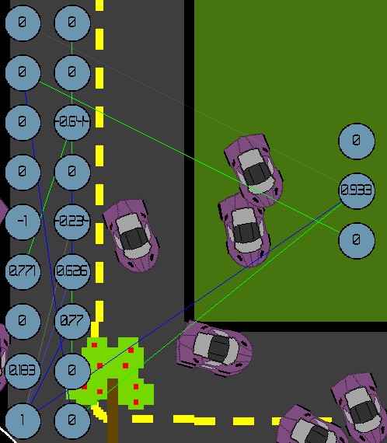
Evolution Parameters cont.
Outputs
0 - Gearshift Neuron
< -0.9 : Shift gear down
> 0.9 : Shift gear up
1 - Acceleration Neuron
< -0.9 : Decelerate
> 0.9 : Accelerate
2 - Turning Neuron
< -0.9 : Turn left
> 0.9 : Turn right
1000 agents per generation
Fitness Function
If the car hasn’t finished the track:
F = 1000 - TA - dt - d
If the car finished:
F = 1000 - time
TanH activation function

Slide 5
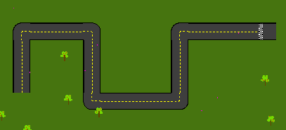
NEAT
Integrated library from Github
Ported inputs, outputs, and fitness function
Multi-threaded the propagate operation
Performance
Lower system resources
Much higher number of generations
Lower resources -> higher sim speed
Complete ~100 generations very quickly
On Test Track, takes ~120-150 generations to complete
Given sufficient time, takes ~8.5 seconds to complete track, which is close to human performance when using the same controls and car

Slide 6
Conclusions
NEAT takes a lot of time to find efficient solutions
Many networks that finish the track have 1 hidden node, and some of the inputs are never even connected
Fixed topology vs NEAT
Throwing darts against the wall vs. traveling to a solution
Fixed topology networks perform worse on longer tracks
Future work
Saving agents and trying them on different tracks
Experiment with the NEAT algorithm parameters

Slide 7
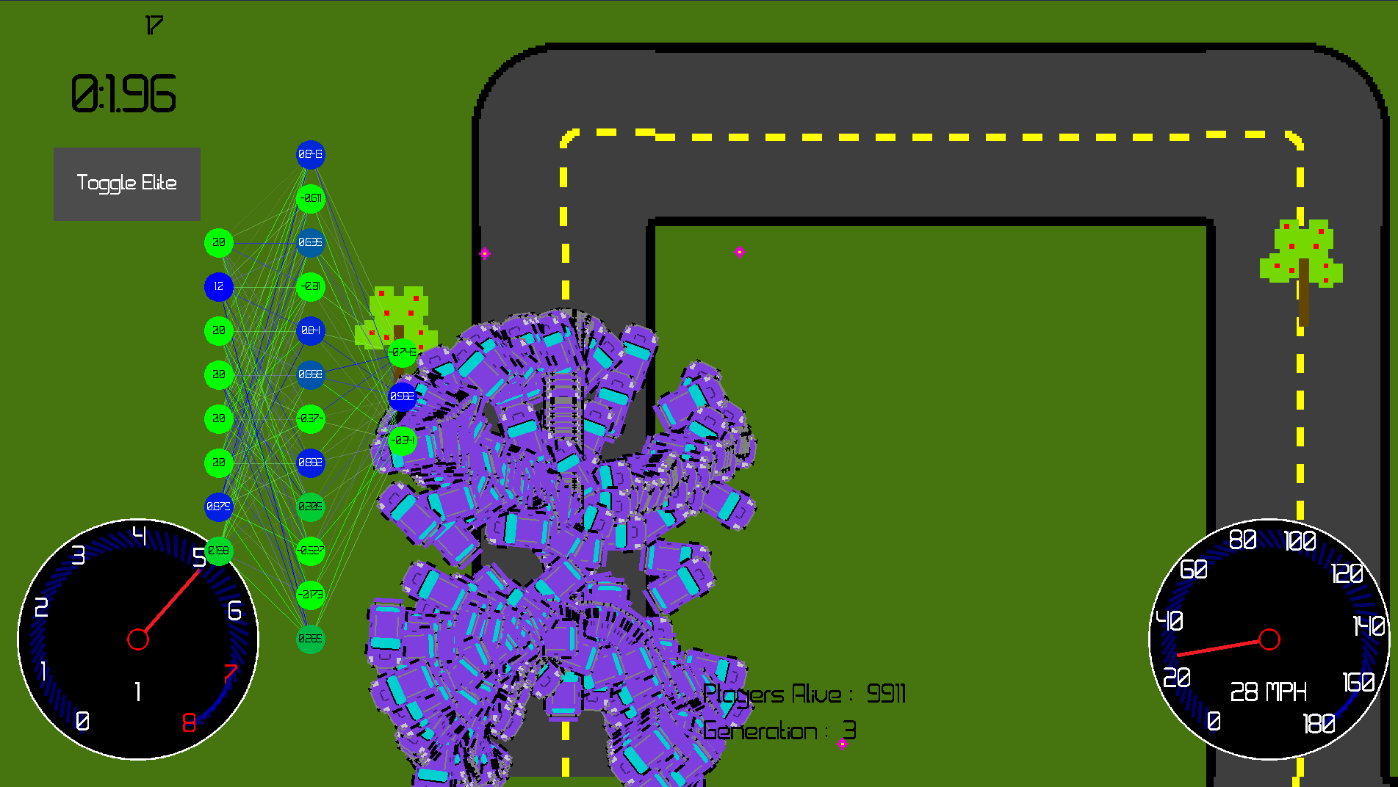
Questions

Slide 8
Source Code
ZoomZoom: https://github.com/HaveANiceDay33/zoomzoom/tree/NEAT
Fixed topology library: https://github.com/HaveANiceDay33/CustomNeuralNetworks/tree/deep-copy-and-activations
RIDVL: https://github.com/osreboot/Ridhvl
NEAT Library: https://github.com/vishnugh/evo-NEAT

